Slide 1

Fundamental Of Structured Programming Lecture 1
Dr. Ahmed Yousry
Lecturer, Computer Science Department,
Faculty of computers and artificial intelligence, benha university

Slide 2


Slide 3
Agenda
Course details
Course instructors
Dependent courses
Learning objectives
Topic covered
Assessment
Grading policy
Previous course statistics
Introduction to Computers and Programming

Slide 4
Course details
Course code | CS141
Course name | Structured Programming
Coordinating unit | Department of Computer Science Faculty of Computer and Artificial Intelligence Benha University
Term | Semester 1
Level | Undergraduate –Level 1

Slide 5
Course instructors
Dr. Mai Kamal
Dr. Naglaa Fathy
Dr. Mohamed Muhammad Ghoneimy
Dr. Ahmed Yousry
Dr. Ahmed Tawfiq

Slide 6
Dependent courses
Object Oriented Programming
Data Structures
Web Programming
Mobile Application Developmen

Slide 7
Learning Objective of the course
Computer Fundamentals & Programming Basics Understand computer components, the program development cycle, and the role of compilers.
Algorithms & Flowcharts Learn to analyze problems, design algorithms, and represent them using flowcharts and pseudocode before coding.
C++ Essentials Write simple C++ programs using variables, constants, input/output, and correct syntax.
Expressions & Interactivity Use arithmetic, relational, and logical expressions while applying correct operator precedence.
Decision Making Implement if, if-else, and switch statements to control program flow effectively.
Loops & Arrays Use while, do-while, and for loops, and process data efficiently using arrays.
Functions & Modular Programming Create and use functions, pass arguments by value and by reference, and apply top-down program design.

Slide 8
Learning Outcomes
After completing this course content, students should be able to:
Explain the basic components of a computer system, the steps in the program development cycle, and the role of algorithms in problem-solving.
Design algorithms and represent them using flowcharts or pseudocode before implementation.
Write simple C++ programs using correct syntax, variables, constants, and input/output operations.
Apply arithmetic, relational, and logical expressions to create interactive programs.
Implement decision-making constructs (if, if-else, switch), loops (while, do-while, for), and arrays to process data efficiently.
Develop modular programs by defining, calling, and organizing functions with proper argument passing.

Slide 9
Topic covered
Introduction to Computers and Programming
Computer components (CPU, memory, input/output devices)
Software vs. hardware
Program development cycle and compilers
Algorithms and Flowcharts
Problem-solving steps
Designing algorithms
Representing solutions using flowcharts and pseudocode
Introduction to C++
Structure of a C++ program
Variables, constants, and data types
Basic input/output operations
Expressions and Interactivity
Arithmetic, relational, and logical expressions
Operator precedence and associativity
Using cin and cout for interactivity

Slide 10
Topic covered
Making Decisions
if, if-else, and switch statements
Nested decisions
Relational and logical operators
Loops
while, do-while, and for loops
Counters, accumulators, and loop control
Arrays
Declaring, initializing, and processing arrays
Iterating through arrays with loops
Functions
Function definitions and prototypes
Argument passing (by value and by reference)
Default parameter
Passing arrays to functions

Slide 11
The Assessment
Final Term Examination | 50%
Midterm Exam | 15%
Oral | 10%
Sections (practical) | 20%
Quiz | 5%

Slide 12
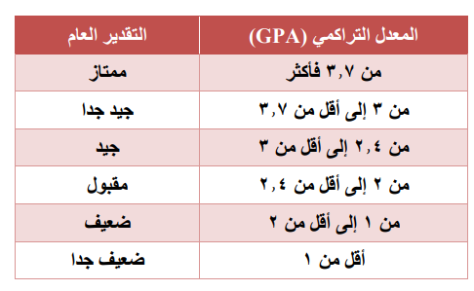
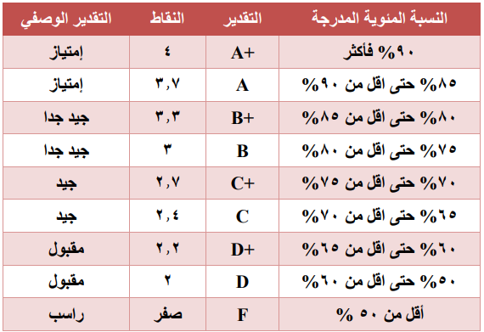
The GPA system

Slide 13
Previous course statistics
Grade | Percentage
A+ | 6.9
A | 10.86
B+ | 11.85
B | 13.95
C | 10.86
D+ | 11.11
D | 22.29
F | 16.27

Slide 14
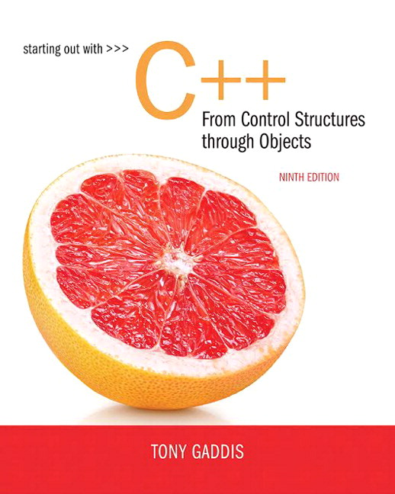
Lectures References
Starting out with C++ From Control Structures through Objects
TONY GADDIS
Ninth Edition.

Slide 15
Course Materials
All course material will be made available on Structured Programming Google Drive Folder
https://drive.google.com/drive/folders/10TvuR863NJJiiZI6BaKl-9LnKFqN8MKv?usp=sharing

Slide 16
Chapter 1 Introduction to Computers and Programming

Slide 17
Why Program?
Computer – programmable machine designed to follow instructions.
Computers can do many different jobs because they are programmable.
Programs are commonly referred to as software
– instructions in computer memory to make it do something
Programmer – person who writes instructions (programs) to make computer perform a task
SO, without programmers, no programs; without programs, a computer cannot do anything

Slide 18
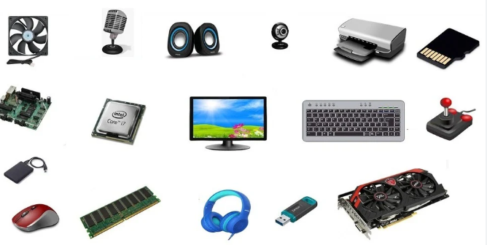

Computer Systems: Hardware and Software
All computer systems consist of similar hardware devices and software components.

Slide 19
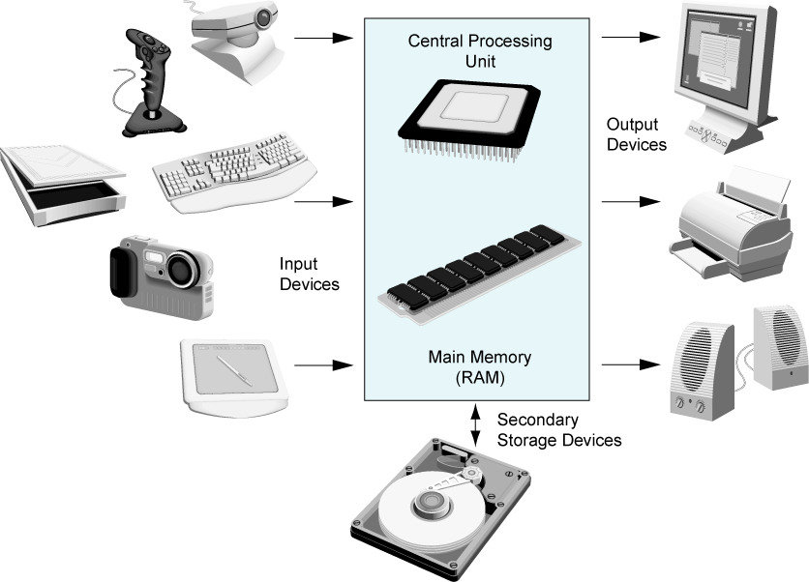
Main Hardware Component Categories:

Slide 20
Main Hardware Component Categories
Hardware refers to the physical components of which a computer is made.
Hardware Component Categories :
Central Processing Unit (CPU)
Main Memory
Secondary Memory / Storage
Input Devices
Output Devices

Slide 21
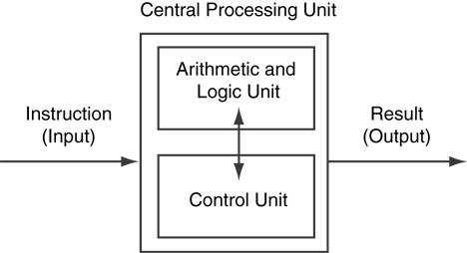
Central Processing Unit (CPU)
Comprised of:
Control Unit
Retrieves and decodes program instructions
Coordinates activities of all other parts of computer
Arithmetic & Logic Unit
Hardware optimized for high-speed numeric calculation
Hardware designed for true/false, yes/no decisions
Notes:
When a computer is performing the tasks that a program tells it to do, we say that the computer is running or executing the program. The central processing unit, or CPU, is the part of a computer that actually runs programs. The CPU is the most important component in a computer because without it, the computer could not run software.

Slide 22
Main Memory
It is volatile. Main memory is erased when the program terminates or the computer is turned off
Also called Random Access Memory (RAM)
A computer's memory is divided into tiny storage locations known as bytes.
One byte is enough memory to store only a letter of the alphabet or a small number.
Each byte is divided into eight smaller storage locations known as bits
bit: smallest piece of memory. Has values 0 (off, false) or 1 (on, true)

Slide 23
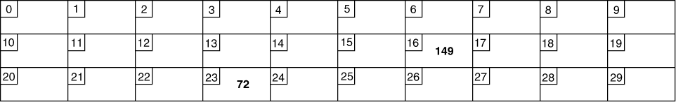
Main Memory
Bytes have addresses
Addresses – Each byte in memory is identified by a unique number known as an address.
The number 149 is stored in the byte with the address 16, and the number 72 is stored at address 23.

Slide 24
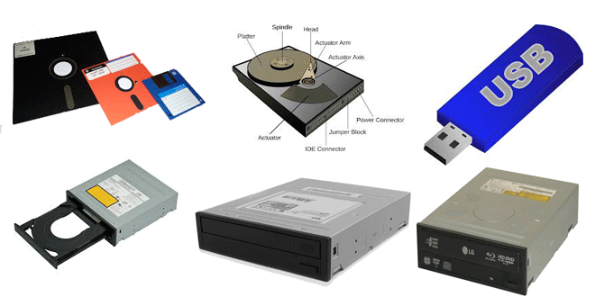
Secondary Storage
Secondary storage is a type of memory that can hold data for long periods of time, even when there is no power to the computer.
Non-volatile: data retained when the program is not running or the computer is turned off
Comes in a variety of media:
magnetic: traditional hard drives
solid-state:
optical: CD-ROM, DVD
Flash drives
Notes:
magnetic: traditional hard drives that use a moveable mechanical arm to read/write
solid-state: data stored in chips, no moving parts
optical: CD-ROM, DVD
Flash drives, connected to the USB port

Slide 25
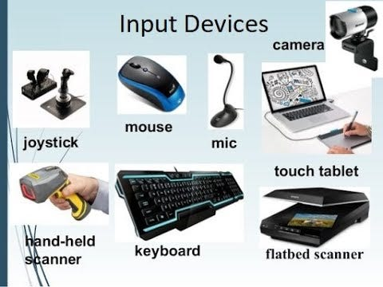
Input Devices
Devices that send information to the computer from outside
Many devices can provide input:
Keyboard,
mouse,
touchscreen,
scanner,
digital camera,
microphone
Disk drives,
CD drives, and
DVD drives

Slide 26
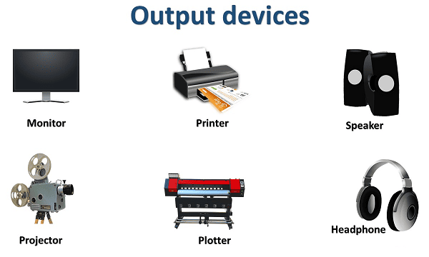
Output Devices
Output is any information the computer sends to the outside world.
Many devices can provide output:
screens,
printers,
and speakers.

Slide 27
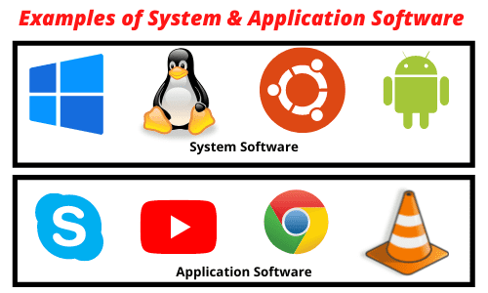
Software
There are two general categories of software: system software and application software.
The programs that control and manage the basic operations of a computer are generally referred to as system software.
Programs that make a computer useful for everyday tasks are known as application software.

Slide 28
Programs and Programming Languages
A program is a set of instructions a computer follows in order to perform a task.
A computer program is a set of instructions that tells the computer how to solve a problem or perform a task.
these instructions are called an algorithm.
A programming language is a special language used to write computer programs.

Slide 29
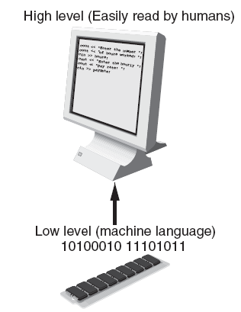
programming languages.
Types of languages:
Low-level: used for communication with computer hardware directly. Often written in binary machine code (0’s/1’s) directly.
High-level: closer to human language

Slide 30
Machine Language
Although the previous algorithm defines the steps for calculating the gross pay, it is not ready to be executed on the computer.
The computer only executes machine language instructions
Machine language instructions are binary numbers, such as 1011010000000101
Rather than writing programs in machine language, programmers use programming languages.

Slide 31
Some Well-Known Programming Languages
C++
BASIC
Ruby
Java
FORTRAN
Visual Basic
C#
COBOL
JavaScript
C
Python

Slide 32
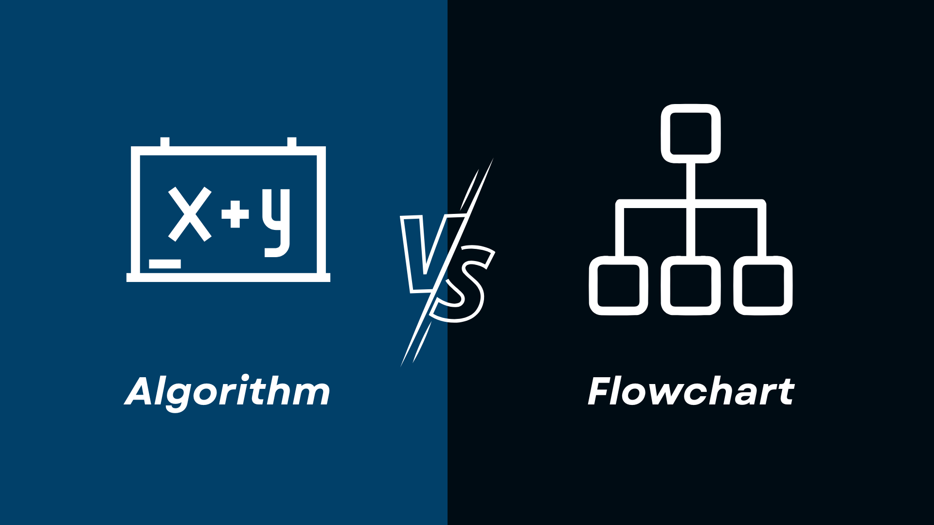
Algorithms and flow chart

Slide 33
Algorithms and Flowchart
Algorithms and flowcharts are used for the representation of a program in a different manner.
The algorithm and flowchart are two types of tools to explain the process of a program.
A typical programming task can be divided into two phases:
Problem-solving phase
produce an ordered sequence of steps that describe the solution of a problem this sequence of steps is called an algorithm
Implementation phase
implement the program in some programming language

Slide 34
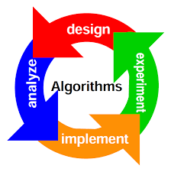
Algorithm
An algorithm is a set of well-defined steps for performing a task or solving a problem.
Notice these steps are sequentially ordered. Step 1 should be performed before Step 2, and so forth.
It is important that these instructions be performed in their proper sequence.

Slide 35
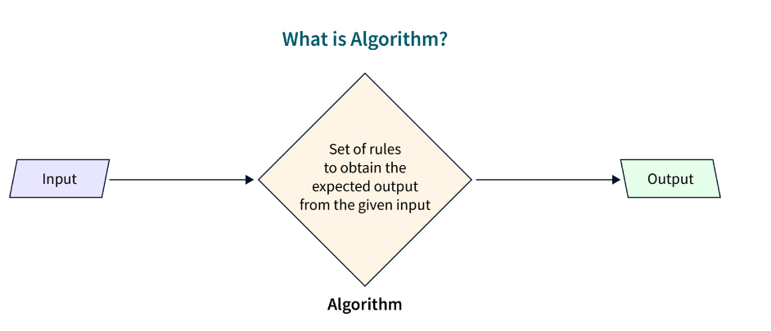
Algorithm
An algorithm is a step-by-step procedure, which has to be followed when an input is given to obtain the desired output or result.
An algorithm is a procedure for solving problems.
In order to solve a mathematical or computer problem, this is the first step in the process.
An algorithm includes calculations, reasoning, and data processing.
Algorithms can be presented by natural languages, pseudocode, and flowcharts, etc.
Notes:
reasoning, التفكير

Slide 36
Example
Algorithm for sum of two numbers
Step 1: Start
Step 2: Enter two numbers in a and b
Step 3: Add a and b and store in c
Step 4: Display c
Step 5: End

Slide 37
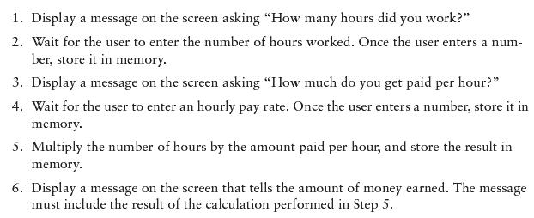
Example Algorithm for Calculating Gross Pay

Slide 38
Pseudocode
Pseudocode is an artificial and informal language that helps programmers develop algorithms.
Pseudocode is very similar to everyday English
Example 1:
Write an algorithm to determine a student’s final grade and indicate whether it is passing or failing.
The final grade is calculated as the average of four marks.
Pseudocode:
Input a set of 4 marks
Calculate their average by summing and dividing by 4
if average is below 50
Print “FAIL”
else
Print “PASS”

Slide 39
Flowchart
a flowchart is a graphical representation of the steps to be followed of a program takes to obtain the desired output.
The flowchart uses many geometric shapes to indicate different steps.
Each geometric shape represents one different step.
The main purpose of using a flowchart is to analyze different methods.
Several standard symbols are applied in a flowchart
Flowchart
shows logic of an algorithm
emphasizes individual steps and their interconnections
e.g. control flow from one action to the next
A flowchart is a diagram made up of Boxes, Diamonds and other Shapes, connected by Arrows.
Each shape represents a step in the process, and the arrows show the order in which they occur.

Slide 40
Standard Symbols used in Flowcharts

Slide 41

The Terminal Symbol
The terminal symbol indicates the beginning and the end of processing.
It contains the words START, STOP, or END.
It is represented by rounded rectangles.

Slide 42
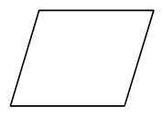
The Input / Output Symbol
The input/output symbol (or I/O symbol) indicates that the computer is to obtain new data or to record the results of computations.
This symbol often contains directions to read records or to print report lines.
It represented by parallelograms.

Slide 43
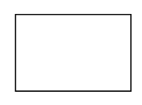
The process symbol
The process symbol contains instructions that are not represented by other symbols.
Process symbols usually contain directions for calculations or for the storage of data.
It represented by rectangles.

Slide 44
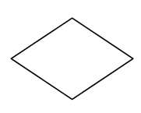
The Decision Symbol
The decision symbol represents a branch in the flow of a program; it must contain directions that indicate which branch to follow.
It represented by Diamond .
This symbol usually contains a question, and each of its branches is labeled with an answer.

Slide 45

Flow direction lines
Flow direction lines indicate the flow of the program.

Slide 46
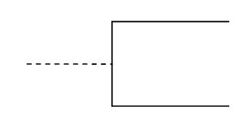
Comments
The comment or annotation symbol is used to annotate other entries.
The dashed line indicates the position of the comment.

Slide 47

The connector Symbol
The connector is used to join areas of a flowchart, in the other word allows you to connect two flowchart segments.
A connector represented by a Small Circle .
The connector is used only when points to be joined occur on the same page.

Slide 48

The off-page Connector Symbol
The off-page connector is used to join areas of a flowchart when the points joined occur on different pages.

Slide 49
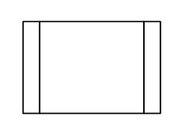
The Predefined Process (Model) Symbol
The predefined process symbol or Model symbol is used to represent a predefined process when the flowcharts that define the process are not included with the current set of flowcharts.
Example:
START
Read Input.
Call calc_pay function.
Display results.
END

Slide 50
Four Flowchart Structures
Sequence
Decision
Repetition
Case

Slide 51
Sequence Structure
A series of actions are performed in sequence

Slide 52
Exercise _1
Design a Flowchart to convert a temperature in degrees Fahrenheit to degrees Celsius.
Hint: Celsius = 5/9 * (Fahrenheit – 32).
Start
Read Fahrenheit
Celsius = 5/9 * (Fahrenheit – 32)
Output
Celsius
End

Slide 53
Exercise_2
Design a Flowchart that accepts two numbers and computes their sum, difference, product, and quotient.
Start
Read Num1
Read Num2
Sum = Num1 +Num2
Difference = Num1 - Num2
Product = Num1 * Num2
Quotient = Num1/Num2
Print Sum
Print Difference
Print Product
Print Quotient
END

Slide 54
Exercise _ 3
You work in a store that sells imported fabric. Most of the fabric you sell is measured in square yards, but your customers want to know the equivalent amount in square meters. Design an Flowchart to perform this conversion.
Hint:
1 square meter = 1.198 yards
Start
Read value in Yard (Y)
Square meter Value (S) = Y/1.198
Output S
END

Slide 55
Exercise _ 4
Design a Flowchart that computes the employee’s gross salary and Net salary given the hours work and the hourly rate. Assume that 15% of the salary is deducted as taxes.
Start
Read Hours Work (H)
Read Hourly Rate (R)
Gross Salary = H * R
Tax = (15/100) * Gross Salary
Net Salary = Gross Salary - Tax
Print Net Salary
END

Slide 56


Exercise _ 5
Design a Flowchart that computes the distance between two points (X1, Y1) and (X2,Y2).
Hint: Distance =
Start
Read X1
Read X2
Read Y1
Read Y2
Z1 = (x1 – x2)
Z2 = (y1 – y)
Distance =
Output Distance
END

Slide 57
Decision Structure
One of two possible actions is taken, depending on a condition

Slide 58
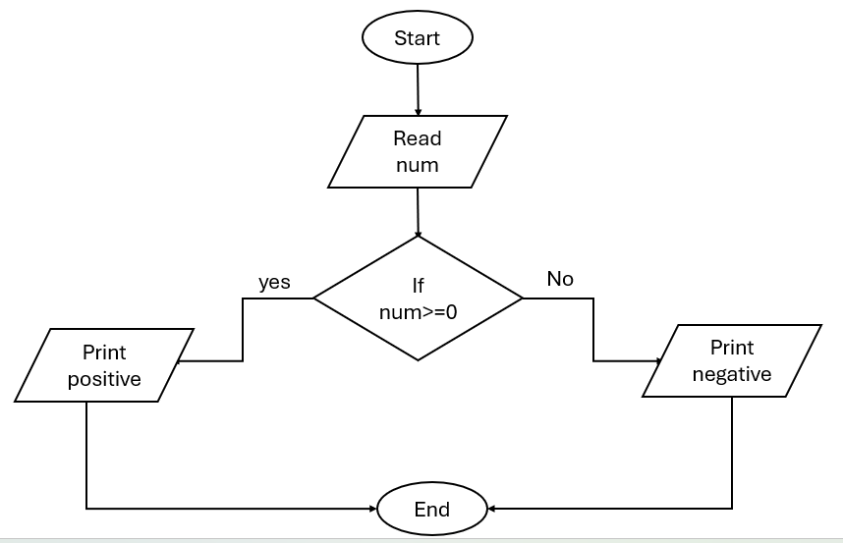
Exercise _ 6
Create a Flowchart that represents the process of checking if a number is positive or negative

Slide 59
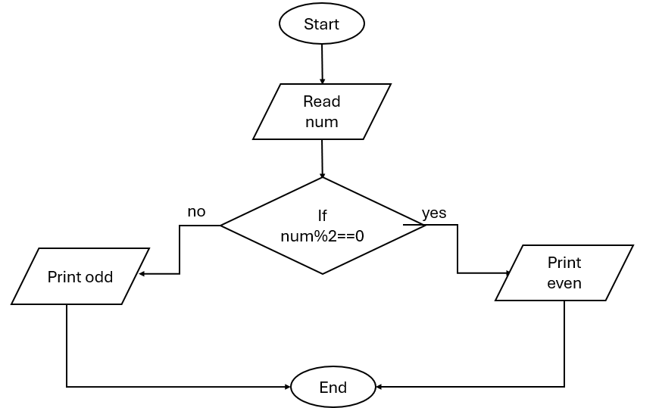
Exercise _ 7
Create a Flowchart that represents the process of checking if a number is even or odd

Slide 60
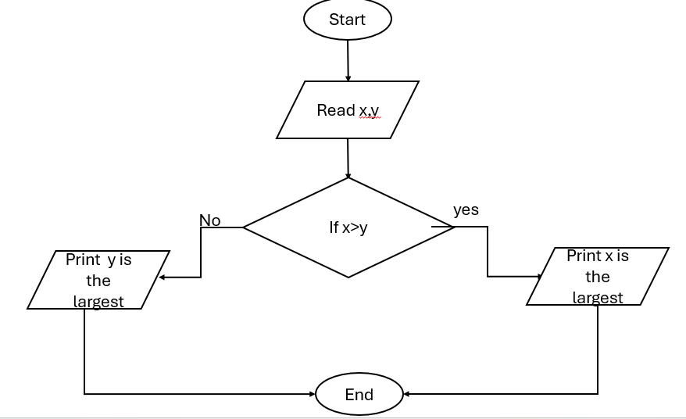
Exercise _ 8
Create a Flowchart to read two numbers then display the largest.

Slide 61
Exercise _ 9
Design a Flowchart that computes the absolute difference of two values (X and Y), where the difference is (X-Y) or (Y-X), which ever is positive.
START
Read X, Y
IS
X>Y
Diff= Y-X
Diff= X-Y
Print Diff
END

Slide 62
Repetition Structure
A repetition structure represents part of the program that repeats. This type of structure is commonly known as a loop.
Repetition Structure
Post-Test
Pre-Test

Slide 63
Repetition Structure
In Pre-Test Repetition Structure The condition is tested BEFORE any actions are performed.
In Post-Test Repetition Structure The condition is tested AFTER the actions are performed
YES
x < y?
Display x
Add1 to x
Display x
Add 1 to x
YES
x < y?

Slide 64
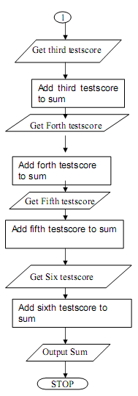
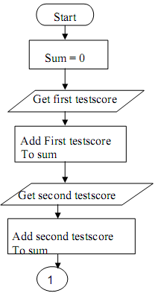
Exercise _ 9
Design a flowchart for adding the test scores as given below: 26, 49, 98, 87, 62, 75

Slide 65
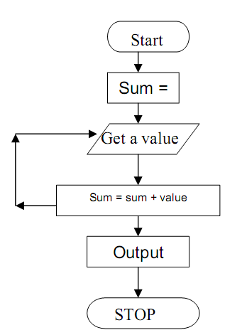
Exercise _ 10
The problem with Exercise_6 have some steps appear more than once, i.e. step 5 get second number, step 7, get third number, etc. One could shorten the algorithm or flowchart as follows:

Slide 66
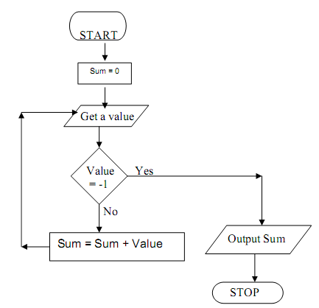
Exercise _ 11
In Exercise_6, step 3 to 5 will be repeated, where a number is obtained and added to the sum . So, we can use repetition structure to represent the answer by adding terminal value to end loop

Slide 67
Exercise _ 12
In Exercise_6, step 3 to 5 will be repeated, by using for loop.
START
Count=6
Sum = 0
n = 1
IS n <= Count
Get number
Sum = Sum + number
n= n+ 1
Print Sum
END

Slide 68
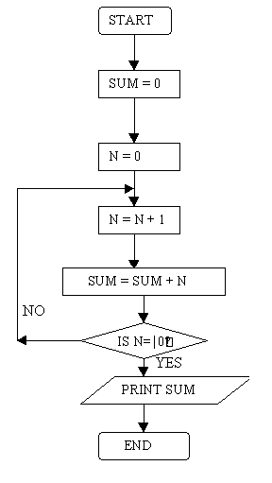
Exercise _ 13
Create a flowchart that read 100 numbers and then display the sum.

Slide 69
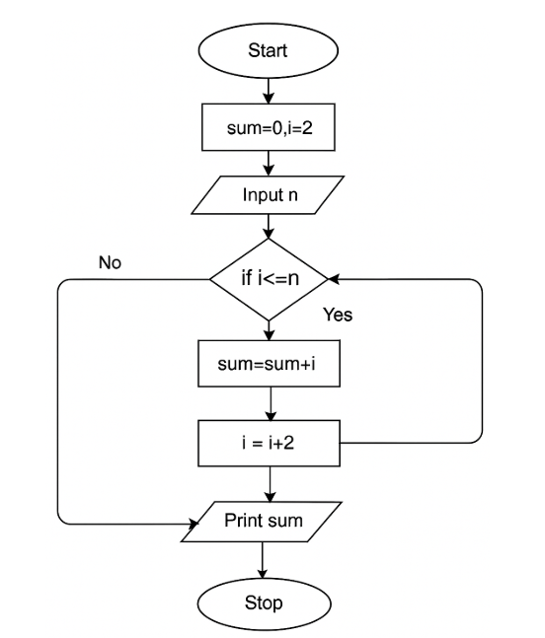
Exercise _ 14
Design an algorithm and the corresponding flowchart for finding the sum of the numbers 2, 4, 6, 8, …, n

Slide 70
Case Structure
One of several possible actions is taken, depending on the contents of a variable.

Slide 71
Case Structure
Example:
If years employed = 2, bonus is set to 200
If years employed = 3, bonus is set to 400
If years employed = 1, bonus is set to 100
If years employed is any other value, bonus is set to 800
CASE years employed
1
2
3
Other
bonus = 100
bonus = 200
bonus = 400
bonus = 800

Slide 72
Thank you

